Slide 1
Chapter 13
Leader Election

Slide 2
Leader Election
Breaking the symmetry in system
Similar to distributed mutual exclusion problems, the first process to enter the CS can be the leader
Lamport’s algorithm is not efficient for leader election in a ring

Slide 3
Ring based leader election
No deterministic algorithm for leader election in an anonymous ring
  Initial state is completely symmetric
  All processes take the same action
  The new state is also symmetric
  This can be repeated forever

Slide 4
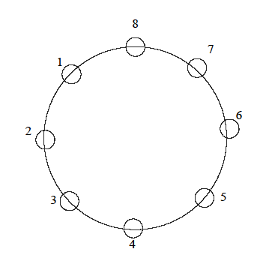
Chang-Robert’s algorithm
Every process sends an election message with its id to the left process if it has not seen a message from a higher process
Forward any message with an id greater than own id to the left
If a process receives its own election message it is the leader
It then declares itself to be the leader by sending a leader message

Slide 5
//Chang-Roberts Leader Election
public class RingLeader extends Process implements Election {
int number;
int leaderId = -1;
int next;
boolean awake = false;
…
public synchronized int getLeader(){
while (leaderId == -1) myWait();
return leaderId;
}
public synchronized void handleMsg(Msg m, int src, String tag) {
int j = m.getMessageInt(); // get the number
if (tag.equals("election")) {
if (j > number)
sendMsg(next, "election", j); // forward the message
else if (j == number) // I won!
sendMsg(next, "leader", myId);
else if ((j < number) && !awake) startElection();
} else if (tag.equals("leader")) {
leaderId = j;
notify();
if (j != myId) sendMsg(next, "leader", j);
}
}
public synchronized void startElection() {
awake = true;
sendMsg(next, "election", number);
}
}

Slide 6
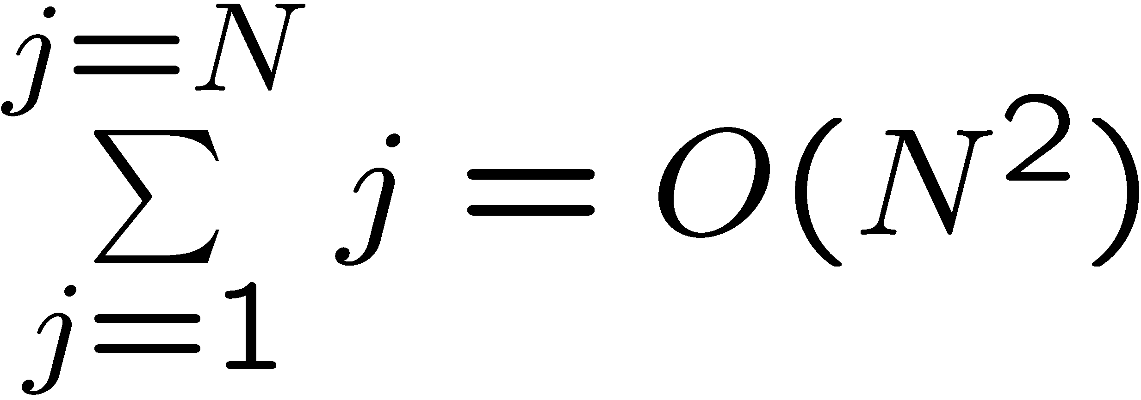
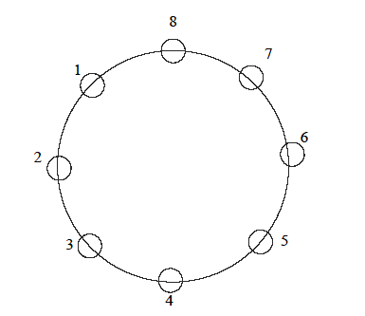
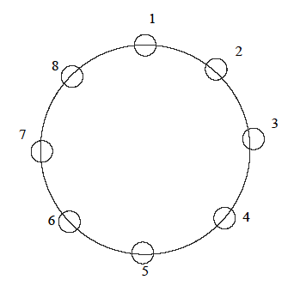
Chang Roberts Leader Election
Worst case message complexity
Best case
Worst case

Slide 7
Hirschberg-Sinclair algorithm
Assume ring is bidirectional
Carry out elections on increasingly larger sets
Algorithm works in asynchronous rounds
Only processes that win the election in round r can proceed to round r+1
Algorithm: P_{i} is the leader in round r iff it has the largest id of all nodes that are at a distance 2^{r} or less from P_{i}

Slide 8
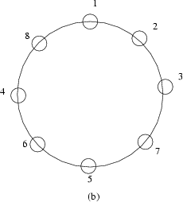
Hirschberg-Sinclair algorithm
Initially:
  All processes are leaders
Round 0:
  6 , 7 and 8 are leaders
Round 1:
  7, 8 are leaders
Round 2:
  8 is the only leader
At most log(N) rounds

Slide 9
Election on general graphs
Totally connected graph – use Lamport’s mutex algorithm
If the graph is not completely connected
  Construct a spanning tree

Slide 10
Spanning tree construction
Assume a distinguished process root (we will remove this assumption later)
root initiates the algorithm by sending an invite to all neighbors
When P_{i} receives an invite for the first time, (say from P_{j}) it sends the invite to all processes except P_{j} and sends accept to P_{j} (i.e. P_{j} is now the parent of P_{i})
P_{i} replies with a reject to all invites received later
All processes maintain the # of nodes from which they have received messages

Slide 11
public class SpanTree extends Process {
public int parent = -1; // no parent yet
public IntLinkedList children = new IntLinkedList();
int numReports = 0; boolean done = false;
public SpanTree(Linker initComm, boolean isRoot) {
if (isRoot) {
parent = myId;
if (initComm.neighbors.size() == 0)
done = true;
else
sendToNeighbors( "invite", myId);
}
}
. . .
public synchronized void handleMsg(Message m, int source, String tag) {
if (tag.equals("invite")) {
if (parent == -1) {
numReports++;
parent = source;
sendMsg(source, "accept")
for (int i = 0; i < N; i++)
if ((i != myId) && (i != source) && isNeighbor(i))
sendMsg(i, "invite");
} else
sendMsg(source, "reject");
} else if ((tag.equals("accept")) || (tag.equals("reject"))) {
if (tag.equals("accept")) children.add(source);
numReports++;
if (numReports == comm.neighbors.size()) {
done = true;
notify();
} } } }

Slide 12
Spanning tree
This algorithm can be also used for broadcast by flooding when there is no predefined spanning tree
If there is no distinguished process
  each process can start the spanning tree construction
  All messages in the spanning tree started by P_{i} contain the id of P_{i}
  Only the instance started by the largest process succeeds

Slide 13
Application: Computing global functions
If we have variable x_{i} at process P_{i}:
  Compute a function f(x₁,x₂,x₃ ,…,x_{n})
Assume we have a predefined spanning tree and use convergecast and broadcast to compute the global function

Slide 14
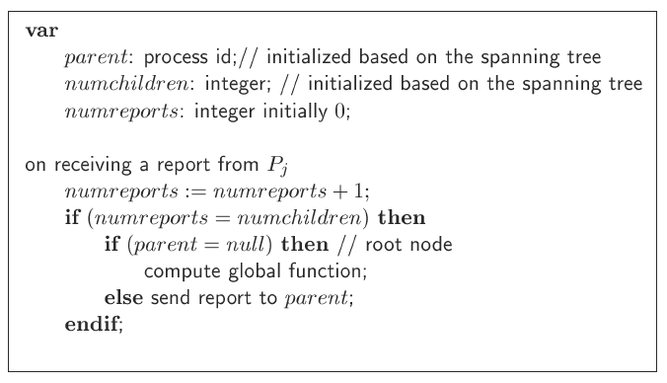
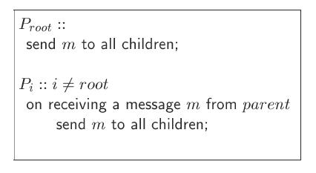
Convergecast
Broadcast

Slide 15
Computing a global function
Assume the global function is commutative and associative
Eg. min, max, sum, product
Each node of the tree computes the function using its value and the values received from its children
This partial answer is sent to the parent
When the root computes the final value, it broadcasts the answer

